Slide 1

Advanced Analytics in Fundraising
IESEG School of Management - MBDA 2020
10 December, 2020

Slide 2
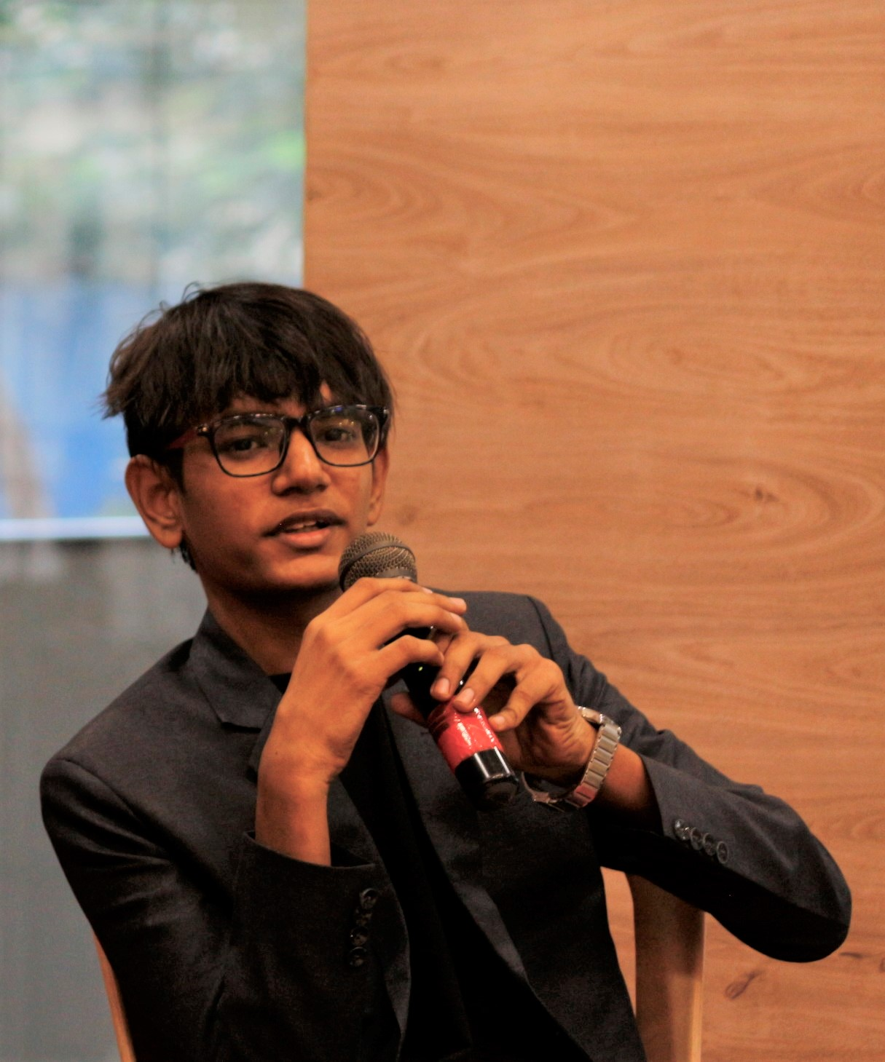
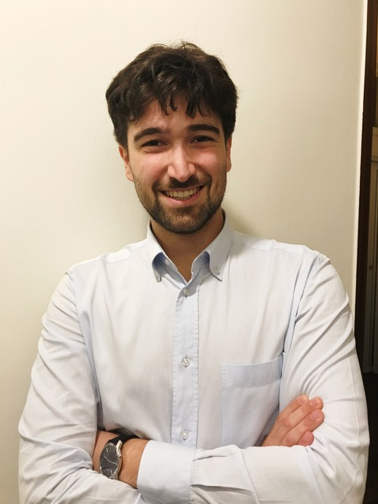

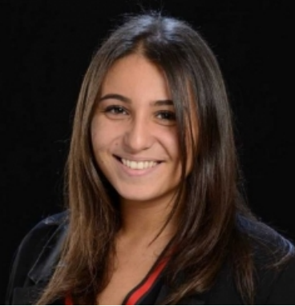
OUR TEAM
ROHIT BHALERAO
ALESSIO ROSATO
You can replace the image on the screen with your own
POOJA SHAH
ROXANE SMADJA

Slide 3
01
PROJECT DEFINITION
02
DATA PREPARATION
TABLE OF CONTENTS
03
FEATURE SELECTION
04
MODEL BUILDING
05
MODEL VALIDATION
MODEL USAGE
06

Slide 4
PROJECT DEFINITION
01

Slide 5

QUICK BACKGROUND
Client: Direct Social Communication - A company that raises funds for charities
Action: Send multiple mails to people and gather funds in a return mail
Campaign: Physical mails sent to prospective donors
Recurrence: Up to 3 times a month​
Project Goals: ​
Reduce costs of ineffective mailings by optimizing the target and increase the donations
Target the donors for campaigns that are more likely to donate based on their profiles
Create a model that overperforms the 1,8% current success rate of campaigns

Slide 6

TABLES
CAMPAIGNS
TIMELINE
FILTER
Gifts
Data of donations made from year 2000 for different campaigns
Campaigns
Data from year 2004 for different donation campaigns
Each dataset dates filtered to get useful information from the past for each donors
For training data, only the data before campaign 6169 is used while for 7662 campaign, entire data is used in our models
Campaign 6169 (training set) took place on 04/09/2018
Campaign 7244 (test set) took place on 18/06/2019​

Slide 7

DATA PREPARATION
02

Slide 8
DONORS TABLE
Missing Zipcodes and Region: Only 6 donors in total had the language ‘EN’ including both these missing entries. The missing values were replaced by information from remaining 4 profiles - Region: Flanders, Province: Flemish Brabant and Zip: 3080.​
Age: Calculated the donor’s age from the DOB. ​
Dummy encoded variables: ​
Gender – IsMale, IsFemale, IsMissingGender​
Region – IsFromFlanders, IsFromBrussels, IsFromWallonia, IsMissingRegion​
Language – Speaks_NL, Speaks_FR​
Province – 11 new columns, one for each province and a column IsMissingProvince

Slide 9
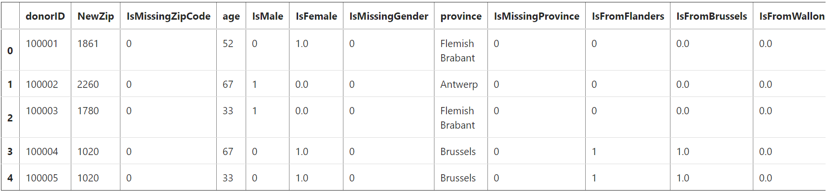
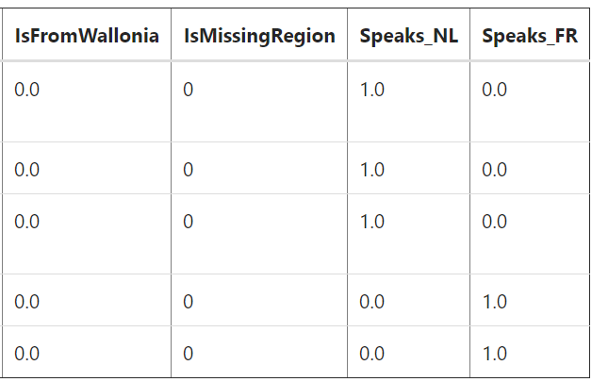
DONORS TABLE

Slide 10
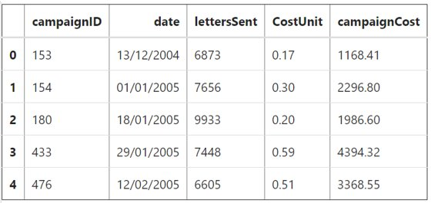
CAMPAIGNS TABLE
campaignCost: Calculated total cost of campaign as the product of unit cost and the number of letters sent​

Slide 11
GIFTS TABLE
Missing Campaign IDs: 2278 donations were between 2000 – 2004 for which campaigns data is unavailable and 13359 donations are not associated with any campaign. These missing fields assigned value 0 under new variable IsMissingCampaignID, keeping original intact
Outliers: Removed donation amounts with outliers using z-score / IQR method
Date: Converted to the right format​
Aggregation to find the total number of donations and total amount donated by each donor in the past and in the last 5 years, 3 years and 1 year

Slide 12
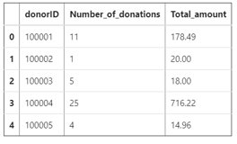
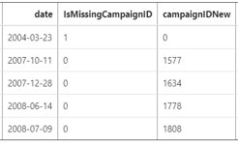
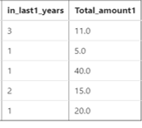
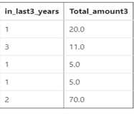
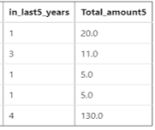
GIFTS TABLE

Slide 13

FEATURE SELECTION
03

Slide 14
FEATURE SELECTION
For selecting the most impactful features for our model, we assessed the AUC score of each of the features on the training and test set using different models and selected one with good AUC scores and also flexible – Logistic Regression
We used single-model univariate feature selection process to get AUC score for each independent variable under logistic regression and kept only those features that scored above 50% probability and used them for training our models: from 29 to 20 features
To verify the consistency of the results from the selected features, we also did multi-model univariate feature selection process. As the outcome was positive, we continued with 20 features shortlisted by the previous model including age regions, last donation period, language and gender

Slide 15
MODEL BUILDING
04

Slide 16
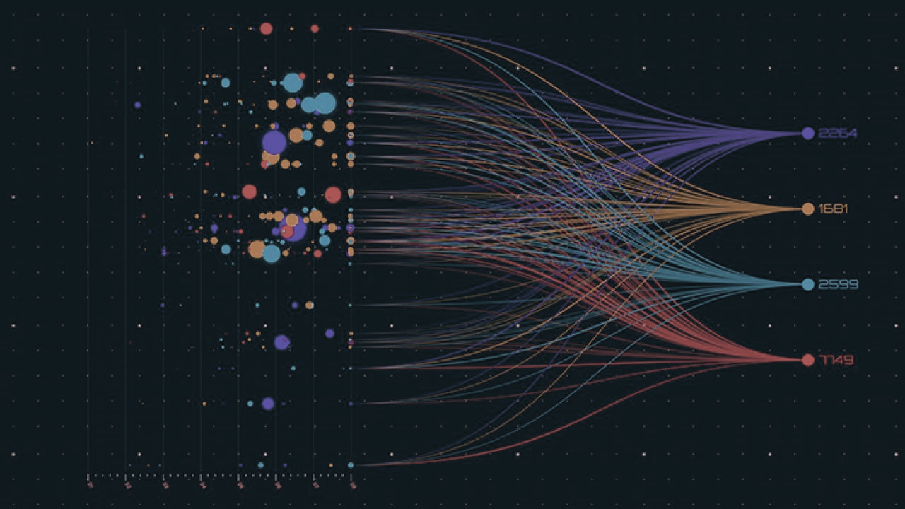
MODELS USED
4 different training and testing datasets to compare the performance of different models
ML models used:
Decision Tree Classifier
Logistic Regression Classifier
Random Forest Classifier
Gradient Boosting Classifier
SVM
Neural Networks
K-Nearest Neighbors (KNN)

Slide 17
SET 1
SET 2
MODELS RUN ON 4 SETS
SET 3
SET 4
Equal number of donors (1191) and non-donors (1191) from the campaign 6169 training data randomly selected
This ensures that the model is not biased towards predicting 0’s as the original training data has 34697 non-donors (0’s) and only 1191 donors (1’s).
75% data used for training and 25% for testing
Equal number of donors (1191) and non-donors (1191) from the campaign 6169 training data randomly selected
We use the entire data to train the models and test the model on the campaign 7244 data.
Entire training data of campaign 6169 with ~ 35K rows and entire testing data of campaign 7244 with ~ 25K rows
Entire training data of campaign 6169 campaign
75% to train and 25% to test the data
Then we use the best model on the test data (7244 campaign)

Slide 18

MODEL VALIDATION
05

Slide 19
Set 1 Result:
# DONORS = # NON-DONORS
Set 2 Result:
Success Rate : 2.88 %
Population targeted: 21.49 %
Cost saved: 4 429.50 €
Best model : Boosted Trees
Accuracy: 77-80 %
On the test set, model predicts that 21.49% of the people will donate of while 2.88% donate.
Success Rate : 3.22 %
Population targeted: 19.35 %
Cost saved: 4 550. 20 €
Best model : Boosted Trees
Accuracy: 76-79 %
On the test set, model predicts that 19.35% of the people will donate of which 3.22% donate.

Slide 20
Set 3 Result:
ENTIRE TRAINING DATA 6169
Set 4 Result:
Success Rate : 55.55 %
Population targeted: 0.00035 %
Cost saved: NA as the targeted rate is impossible to reach
Best model : Logistic Regression
Accuracy: 98.6%
On the test set, the model predicts that 0.00035% (very specific) of the people of will donate, of which 55.55% donate
Success Rate : 2.88 %
Population targeted: 21.48 %
Cost saved: 4430.90 €
Best model : Boosted Trees
Accuracy: 80%
On the test set, the models predict that 21.48% of the people will donate of which, 2.88% donate

Slide 21
3.22%
CAMPAIGN SUCCESS RATE
PERFORMANCE OF BEST MODEL
-80.65%
COST OF CAMPAIGN
IF WE HAVE A LARGE DONOR DATA ~10 million ID's
55.55%
Success Rate

Slide 22
MODEL USAGE
06

Slide 23
Campaign 7662 Dec 15, 2020
Number of donors targeted : 7713 donor IDs Predicted number of donors : 250 Success Rate : 3.22 % Population Targeted : 29.08% New campaign cost : 1696.86 € Cost saved : 4137.98 €
Number of donors in the mailing list :
26522 donor IDs
Number of donors @ 1.8% success rate : 477
Average cost of unit in the last 3 years : 0.22 €
Cost of campaign : 5834.84 €

Slide 24

Female 72 years old Speaks Flemish From Region Flanders
THE PROFILE OF THE IDEAL DONOR

Slide 25
Thank you!

